Slide 1



Developed by:
Christian Marchiori
Fabio Zanini

Slide 2


Introduction
The aim of this project is to create a graph database representing the world of Formula 1.
Formula 1 (a.k.a. F1 or Formula One) is the highest category of single-seat auto racing sanctioned by the Fédération Internationale de l'Automobile (FIA) and owned by the Formula One Group.
The datasets used to create this database contain information regarding races, drivers, driver ratings, constructors, qualifying, circuits, lap times, pit stops, and championships from 1950 until the latest 2023 season.
The project also consists of some SPARQL queries to show how the database works.

Slide 3



Datasets
Formula 1 data:
https://ergast.com/mrd/ or
https://www.kaggle.com/datasets/rohanrao/formula-1-world-championship-1950-2020
The dataset consists of all information on the Formula 1 races, drivers, constructors, qualifying, circuits, lap times, pit stops, championships from 1950 till the latest 2023 season.
Ratings data:
2023: https://ratings-api.ea.com/v2/entities/f1-23-drivers-ratings
Older: https://github.com/toUpperCase78/formula1-datasets
Driver Ratings from EA & Codemasters F1 2021 / F1 22 / F1 23 Official Video Game
Country to Nationality csv:
https://github.com/Imagin-io/country-nationality-list/tree/master
Csv file that maps nationalities to countries.

Slide 4

Development process
Graph schema
Ontology
Serialization
Queries
Graph model designed to fit the F1 data
Developed with arrows.app
Ontology according to the Graph model
Developed with Protégé
Serialization process to produce turtle files
Developed with Jupyter Notebook
Produced some queries to test the database
Developed with SPARQL

Slide 5
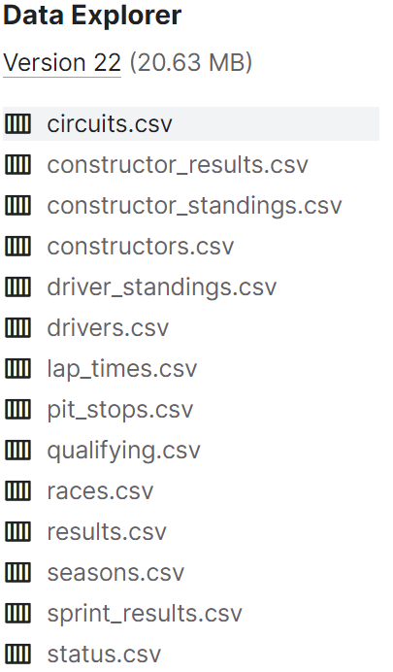
CSV files list
Dataset
circuits.csv (circuits where F1 races are held)
constructor_results.csv (race results of the constructors’ championship)
constructor_standings.csv (final standings of the constructors’ championship)
constructors.csv (constructors in F1)
driver_standings.csv (final standings of the driver's championship)
drivers.csv (drivers in F1)
lap_times.csv (lap times in F1)
pit_stops.csv (pit stops in F1)
qualifying.csv (qualifying in F1)
races.csv (races in F1)
ratings.csv (ratings of F1 drivers)
results.csv (results of F1 races)
seasons.csv (seasons of F1)
sprint_results.csv (results of F1 sprint races)
status.csv (Mapping of various statuses)

Slide 6
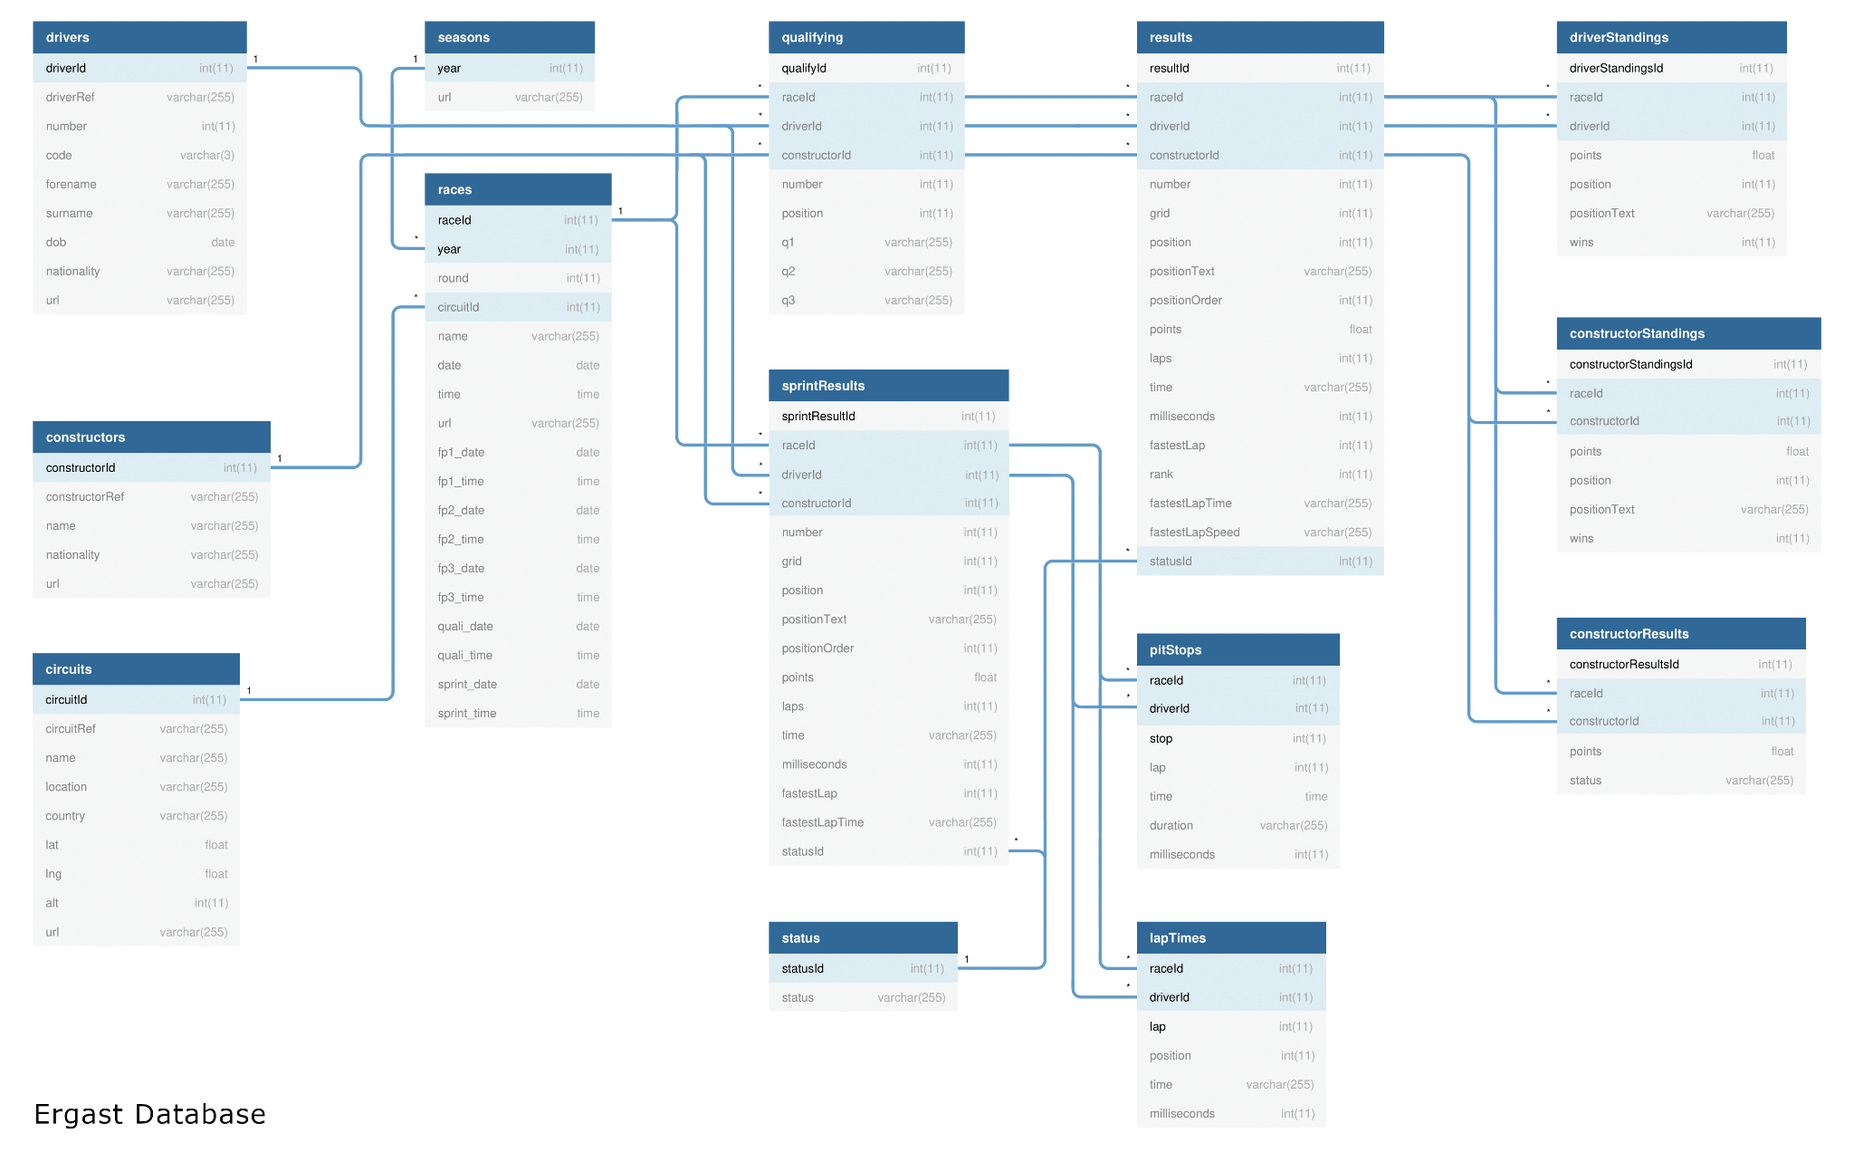
E-R Schema

Slide 7
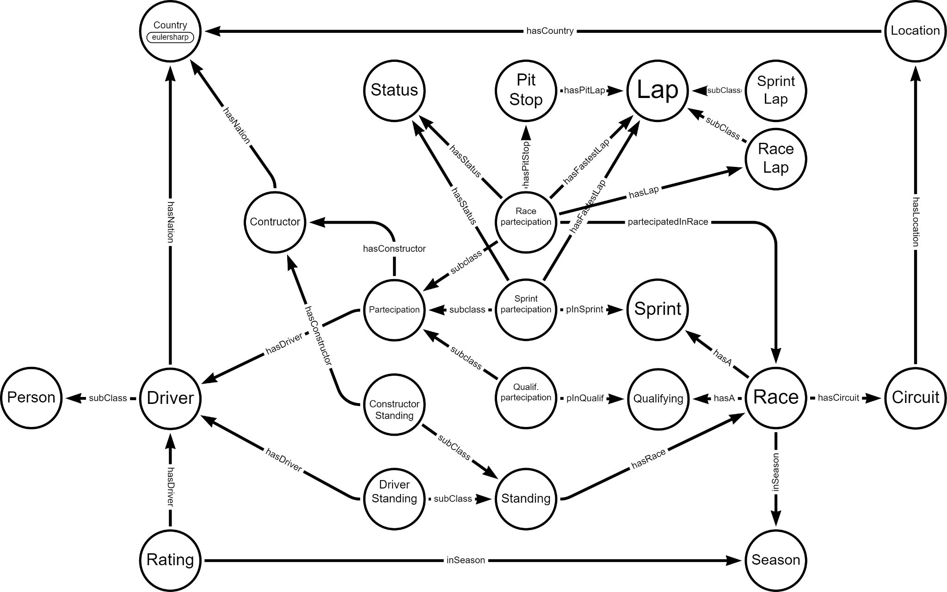
Graph Schema

Slide 8
Ontology

Slide 9
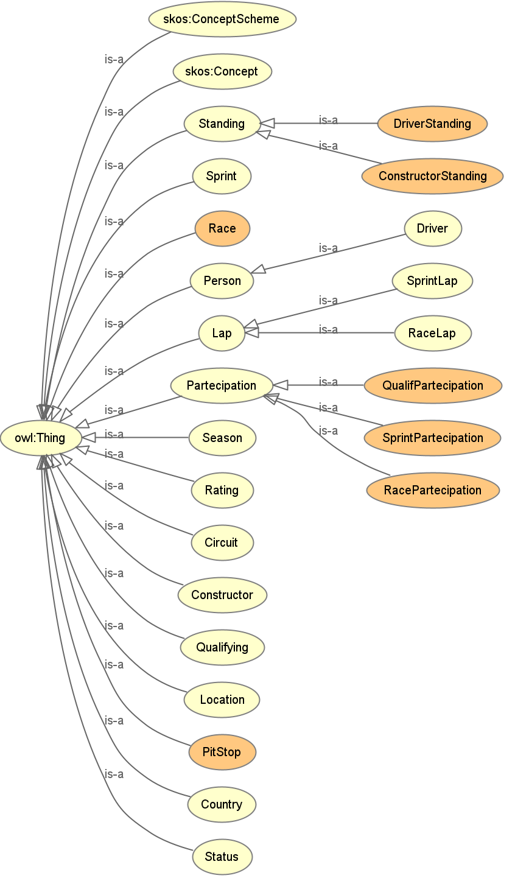
Class hierarchy
Ontology
Standing (represents championship standings)
DriverStanding (...related to drivers)
ConstructorStanding (...related to constructors)
Sprint (represents a sprint race related to a particular race)
Race (represents a particular F1 race)
Person (represents a person in general)
Driver (represents a F1 driver)
Lap (represents a single lap in a generic race)
SprintLap (represents a single lap in a sprint)
RaceLap ((represents a single lap in a race)
Partecipation (represents the participation of a driver and his related constructor team to a race/sprint/qualifying)
QualifPartecipation (...to a qualifying)
SprintPartecipation (...to a sprint)
RacePartecipation (...to a race)
Season (represents a F1 season)
Rating (represents a rating tab for a driver)
Circuit (represents the circuits on which F1 races are done)
Constructor (represents F1 teams)
Qualifying (represents a qualifying related to a particular race)
Location (represents the location/city of a circuit)
PitStop (represents a single pitstop in a F1 race)
Country (represents world countries)
Status (represents a status of a driver or a car in a race/sprint)

Slide 10
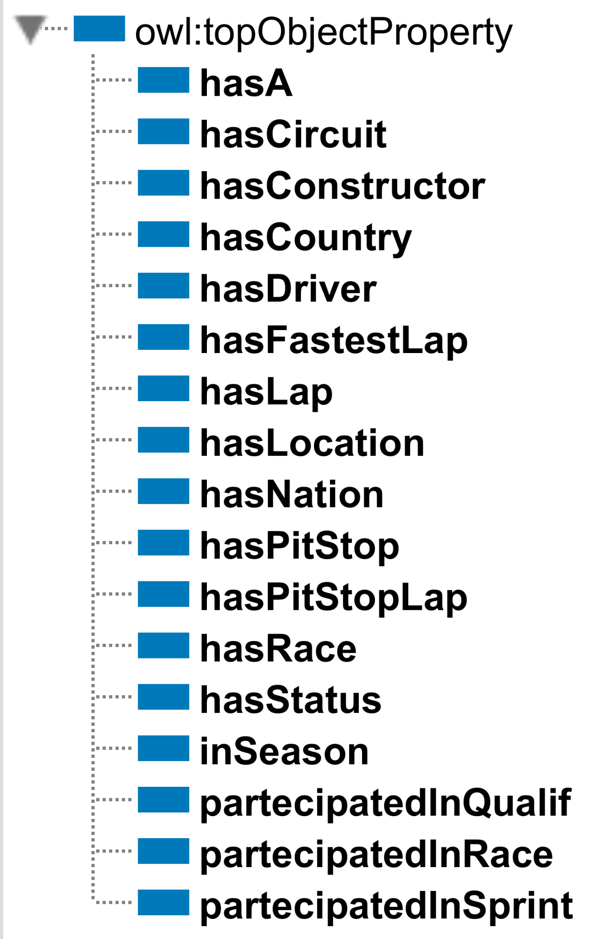
Object properties
Ontology
hasA (Race ↦ Qualifying or Sprint)
hasCircuit (Race ↦ Circuit) F
hasConstructor (ConstructorStanding or Partecipation ↦ Constructor) F
hasCountry (Location ↦ Country) F
hasDriver (DriverStanding or Partecipation or Rating ↦ Driver) F
hasFastestLap (RacePartecipation or SprintPartecipation ↦ Lap) F
hasLap (RacePartecipation ↦ Lap)
hasLocation (Circuit ↦ Location) F
hasNation (Constructor or Driver ↦ Country)
hasPitStop (RacePartecipation ↦ PitStop)
hasPitStopLap (PitStop ↦ Lap)F
hasRace (Standing ↦ Race) F
hasStatus (RacePartecipation or SprintPartecipation ↦ Status) F
inSeason (Race or Rating ↦ Season) F
partecipatedInQualif (QualifPartecipation ↦ Qualifying) F
partecipatedInRace (RacePartecipation ↦ Race) F
partecipatedInSprint (SprintPartecipation ↦ Sprint) F

Slide 11
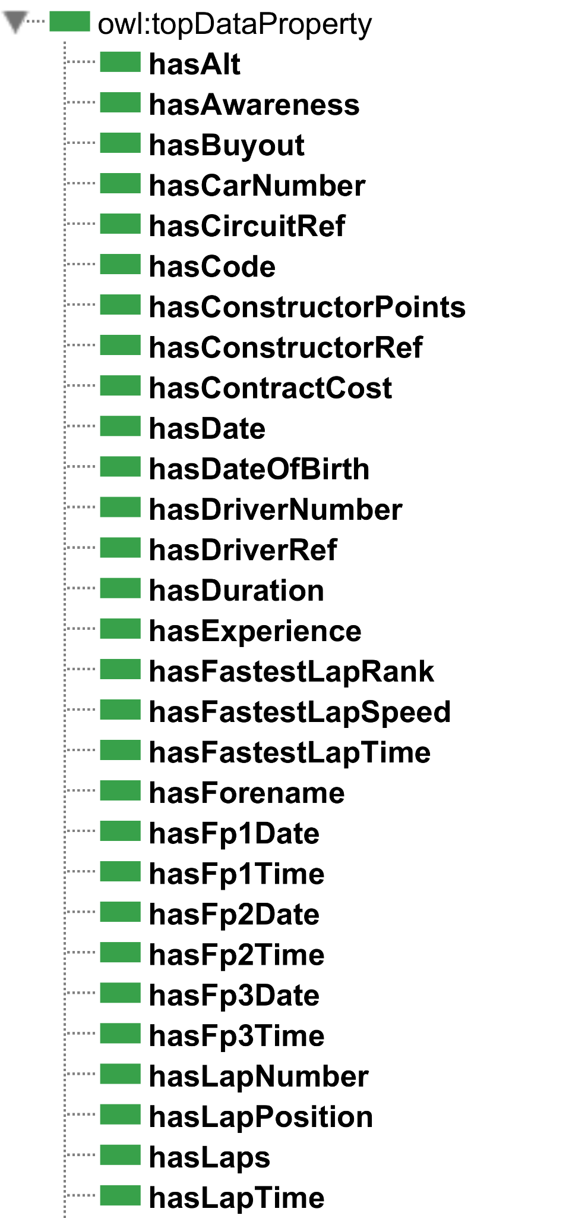
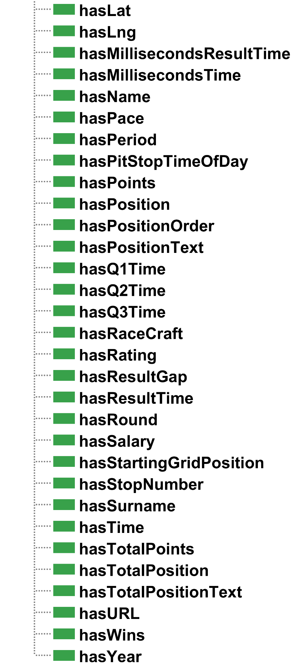
Data properties
Ontology

Slide 12
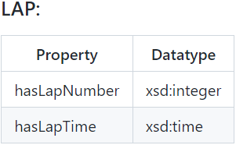
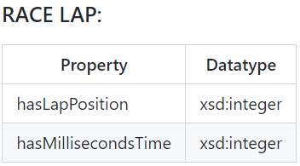
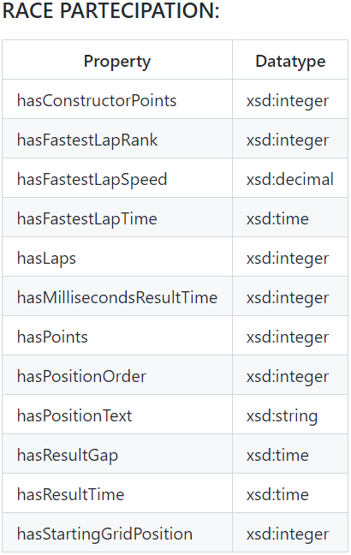
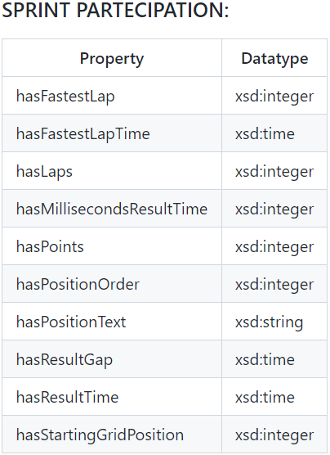
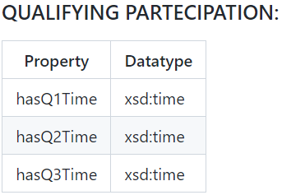
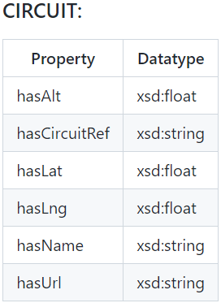
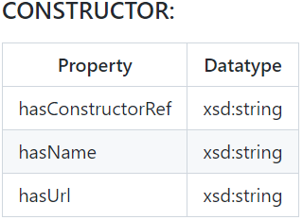
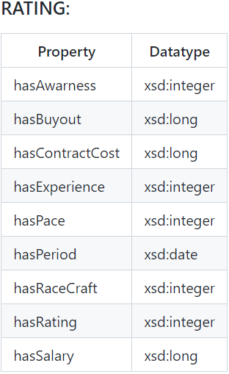
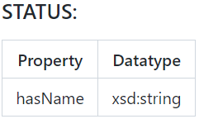
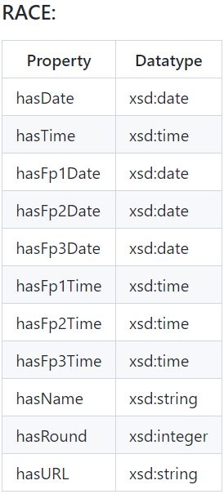
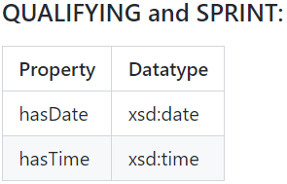
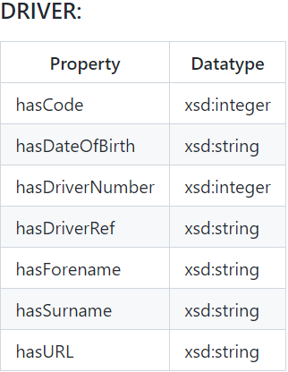
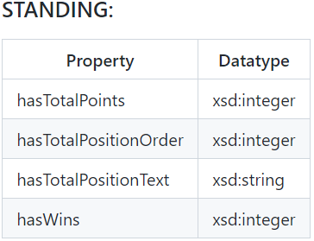
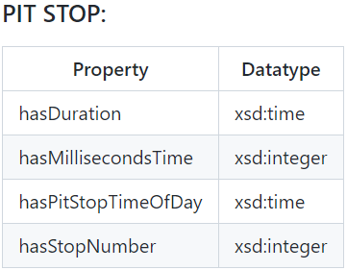
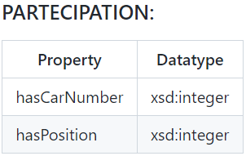
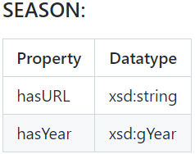
Data properties
Ontology

Slide 13
Serialization

Slide 14
Introduction
Serialization
Turtle files produced by the serialization process:
Turtle files | csv files from which we extracted the data for the turtle files
circuits.ttl | circuits.csv, countries.csv
constructors.ttl | constructors.csv, nationalities.csv
drivers.ttl | drivers.csv, nationalities.csv
laps1.ttl and laps2.ttl | lap_times.csv, results.csv, constructor_results.csv
qualifying.ttl | qualifying.csv, races.csv
race.ttl | races.csv
race_partecipation.ttl | results.csv, constructor_results.csv, lap_times.csv
ratings.ttl | ratings.csv, drivers.csv
sprint.ttl | sprint_results.csv, races.csv
standings.ttl | driver_standings.csv, constructor_standings.csv
status_season.ttl | status.csv, seasons.csv
stops.ttl | pit_stops.csv, results.csv, constructor_results.csv, lap_times.csv

Slide 15



Matching columns
Serialization
Left Join
We joined results.csv and constructor_results.csv in a single Pandas data frame. Then, all the results concerning the constructor team were matched with the driver results before managing the data frame.
Search
For each current row evaluated, we searched for a matching row in the second table in order to match some constraints, such as some keys.
result
constructor_result
left join
join
qualifying
races
search

Slide 16

Nationality to country mapping
Serialization
We used this approach in drivers.ttl and constructors.ttl to maintain a single class country taken by an external source.
In this way, we avoided creating an additional nationality class and it was not necessary to link each individual in the nationality class to the country class via an object property.
The mapping was done directly in the serialization step.
num_code | alpha_2_code | alpha_3_code | en_short_name | nationality
4 | AF | AFG | Afghanistan | Afghan
248 | AX | ALA | Åland Islands | Åland Island
8 | AL | ALB | Albania | Albanian
12 | DZ | DZA | Algeria | Algerian
16 | AS | ASM | American Samoa | American Samoan
20 | AD | AND | Andorra | Andorran
24 | AO | AGO | Angola | Angolan
660 | AI | AIA | Anguilla | Anguillan
10 | AQ | ATA | Antarctica | Antarctic
28 | AG | ATG | Antigua and Barbuda | Antiguan or Barbudan
32 | AR | ARG | Argentina | Argentine

Slide 17
Time format
Serialization
We used 3 functions to manage time:
time_formatter
Function that transforms a time value to the standard %H:%M:%S.%f format, adds the zeros and the missing colon to the beginning and end of the string.
gap_formatter
Function that transforms a gap time value to the standard %H:%M:%S.%f format, adds the zeros and the missing colon to the beginning and end of the string.
time_converter
Function that calculates a driver's actual arrival time using the winner's arrival time and the time distance from it.
17:02.3
t_f
00:17:02.300
1:47:02.345
t_f
01:47:02.345
+7:02.345
g_f
00:07:02.345
+145.31
g_f
00:02:25.310
Driver gap time:
+122.345
Winner arrival time:
1:00:00.000
Driver arrival time:
01:02:02.345

Slide 18
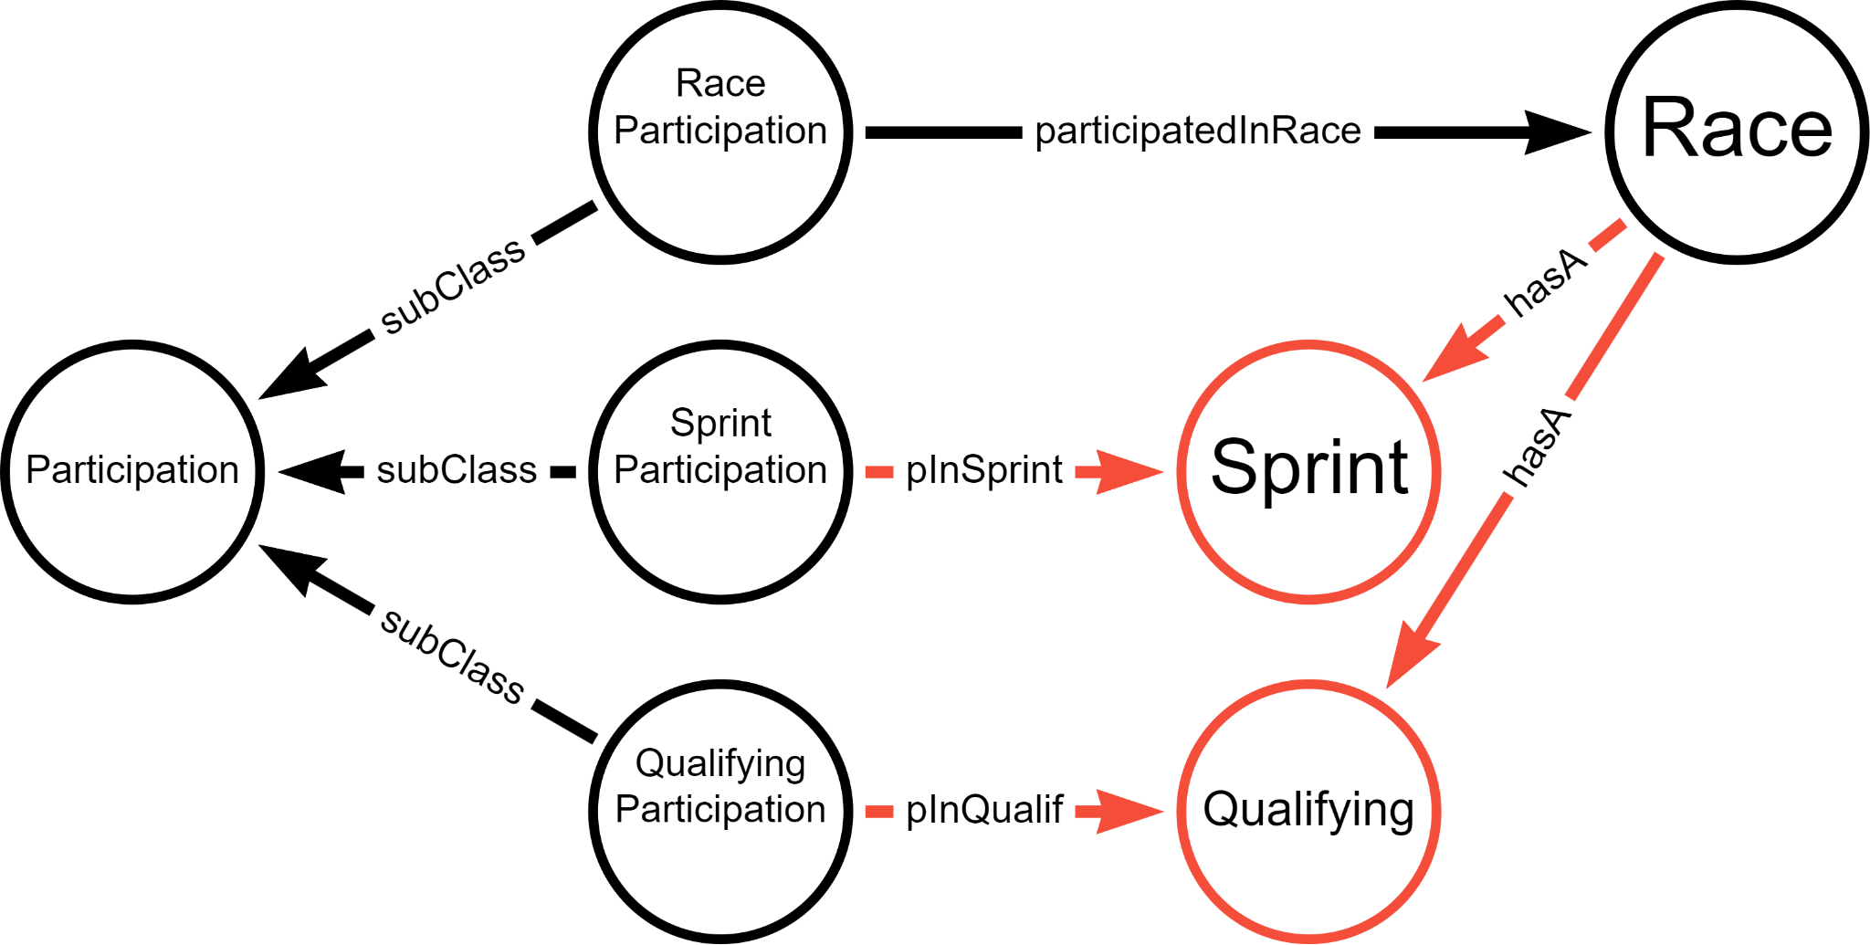
Qualifying and Sprint classes
Serialization
In the source dataset, we have two csv files concerning the races:
the one for the generic race (races.csv) and
the one for each driver's participation in the race (results.csv).
For qualifying and sprints this does not happen and we only have files representing the participations (qualifying.csv, sprint_results.csv).
To make the database more consistent, we decided to add two classes, Sprint and Qualifying, to represent the generic sprints and qualifications, not related to the driver.
To do this, we added the generic qualification with URI "qualifying+raceId" when evaluating qualification participations. In this way, since the raceId is unique for all participations of a specific race, the individual of the generic qualification is added only once.
In addition, we took the columns quali_date and quali_time from races.csv and added them directly to the generic qualification, making the model consistent.

Slide 19
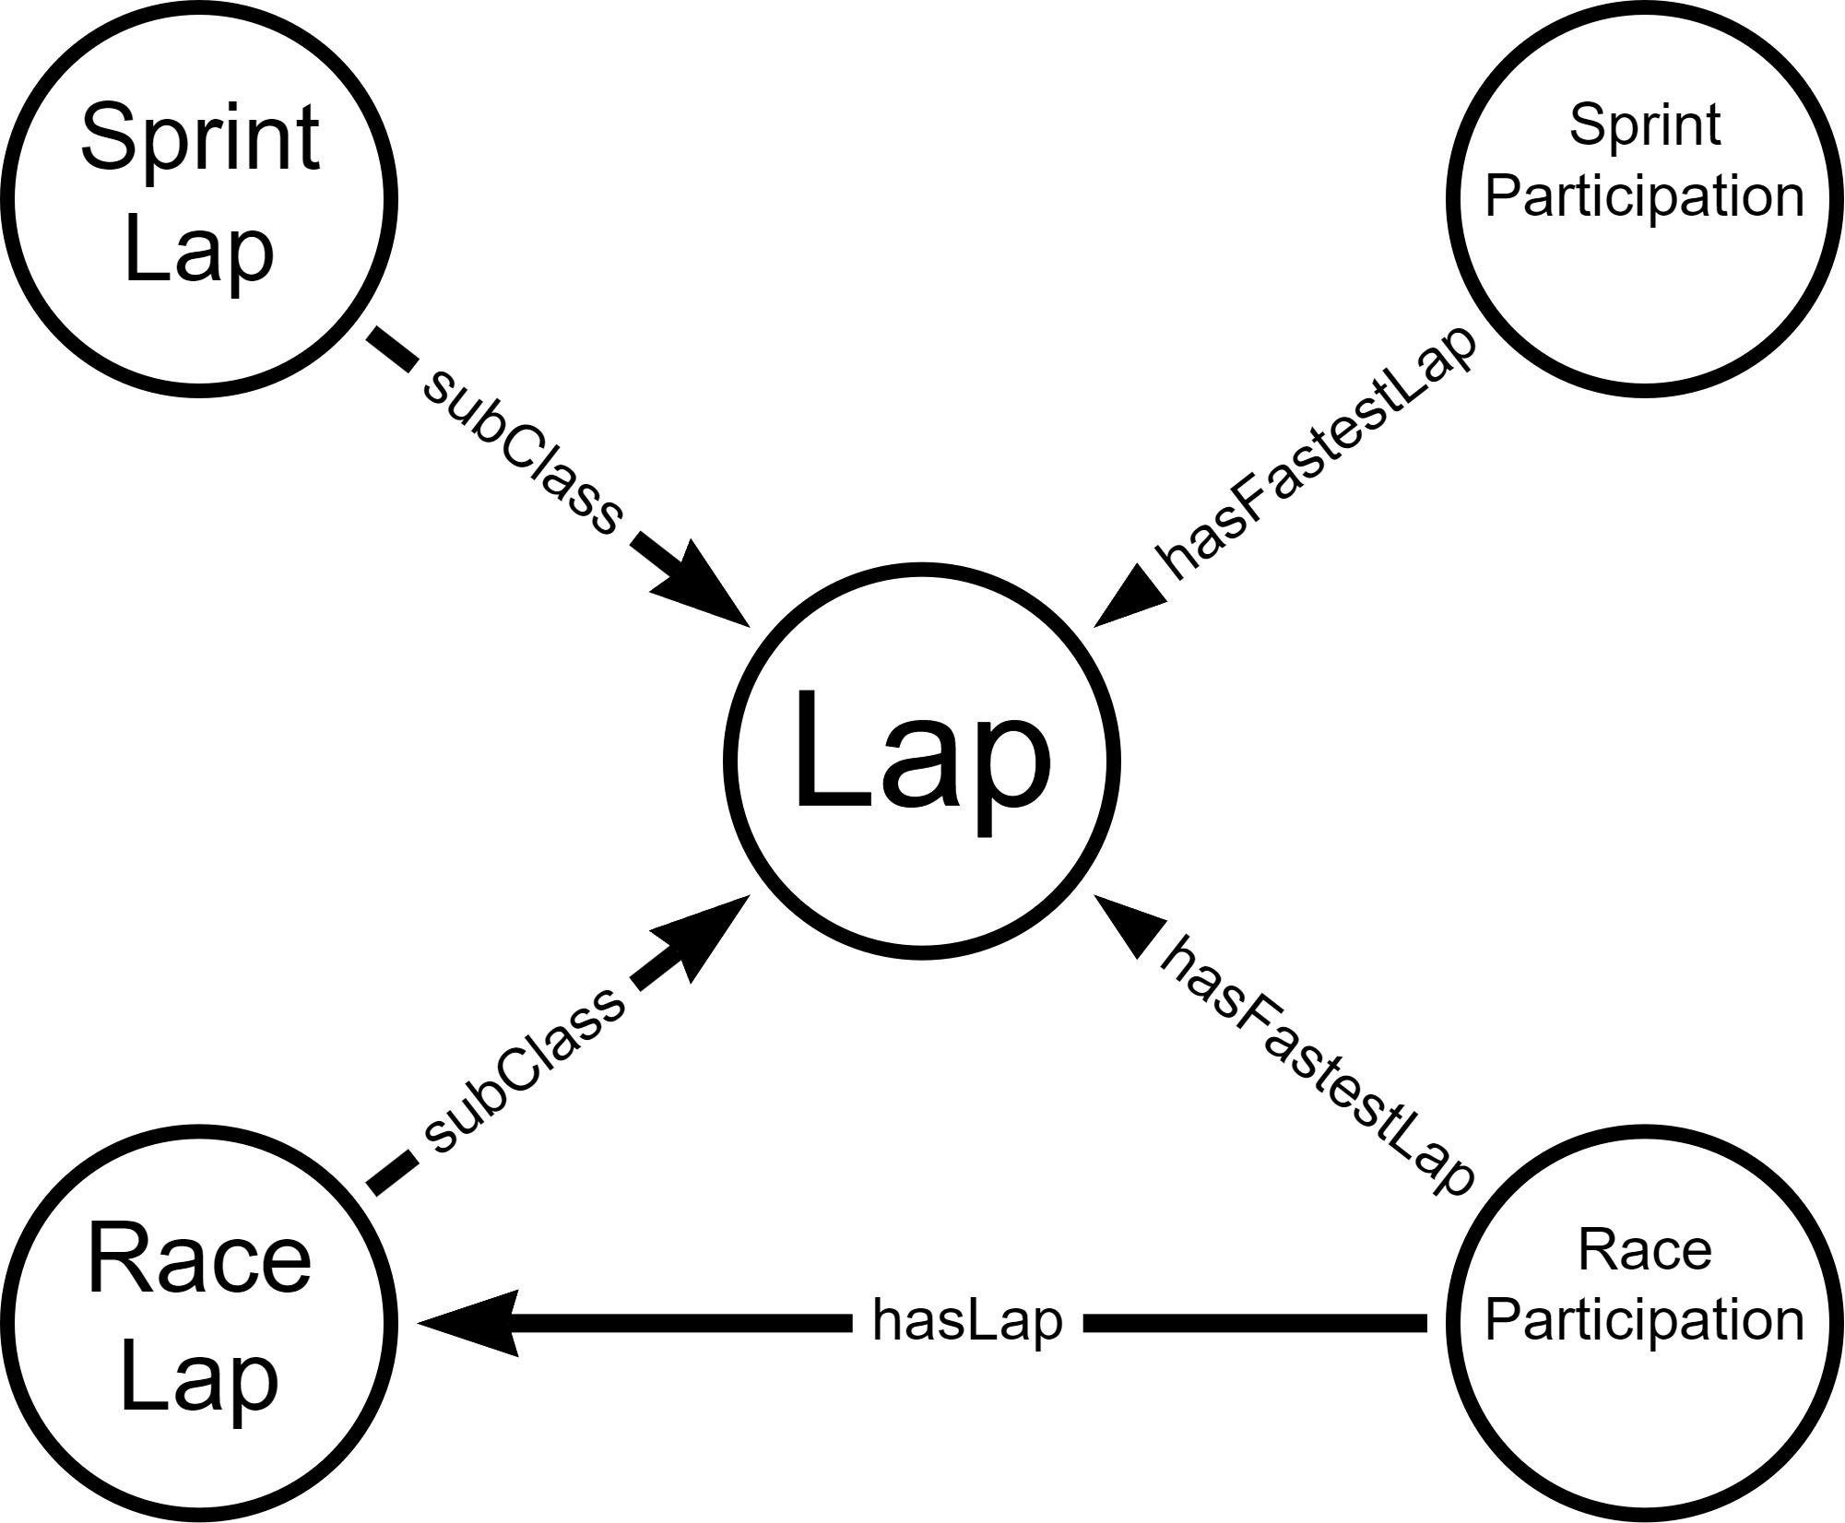
Race and sprint laps
Serialization
In the source dataset, we have the lap_times.csv file that contains all the laps of each driver in each race, with their positions and times.
In the case of the sprints, we do not have all the laps of each driver, but we have only the fastest lap performed by a driver, with the corresponding time.
Consequently, we decided to create a subclass of Lap, called SprintLap to include the fastest laps related to sprints, with related time.
We also chose to keep this information in SprintParticipation so that it would be faster to extract it in SPARQL.
In the case of qualifying, there is no information regarding drivers' laps.

Slide 20
Matching of drivers’ ratings
Serialization
The ratings of the various drivers were extracted from a different dataset than the main dataset.
Consequently, to associate the various ratings with the drivers in the Driver class, during the rating evaluation we do this:
take the driver name (in full format),
split it into two parts (at first whitespace),
get the rows of the drivers dataframe with the first part of the splitted full name (point 2) contained in the forename value of the drivers.csv.
If there exists at least one row in the retrieved data frame (point 3) that in the surname field also contains the second part of the splitted full name (point 2),
get the row of the drivers dataframe with the splitted name values contained in the forename and surname respectively,
get the matching driver URI and connect it with the rating.

Slide 21
Queries

Slide 22
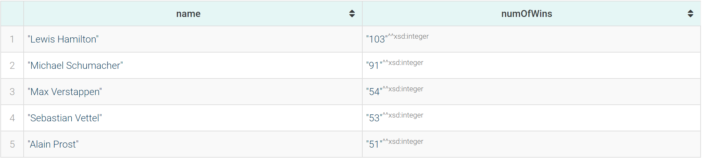
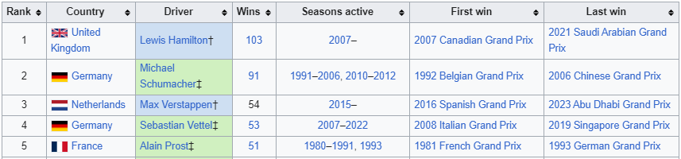
The 5 most winning drivers in F1 history, ordered by number of grand prix wins
Query 8.1
PREFIX : <https://www.dei.unipd.it/db2/groupProject/FASTianF1#>
PREFIX xsd: <http://www.w3.org/2001/XMLSchema#>
SELECT ?name (COUNT(?name) as ?numOfWins) WHERE {
?race :hasCircuit ?circuit;
a :Race.
?racePart :partecipatedInRace ?race;
:hasPositionOrder "1"^^xsd:integer;
:hasDriver ?driver.
?driver a :Driver;
:hasForename ?fname;
:hasSurname ?sname.
BIND(CONCAT(?fname, " ", ?sname) AS ?name).
} GROUP BY ?name
ORDER BY DESC (?numOfWins)
LIMIT 5
SPARQL RESULT:
WIKIPEDIA:

Slide 23
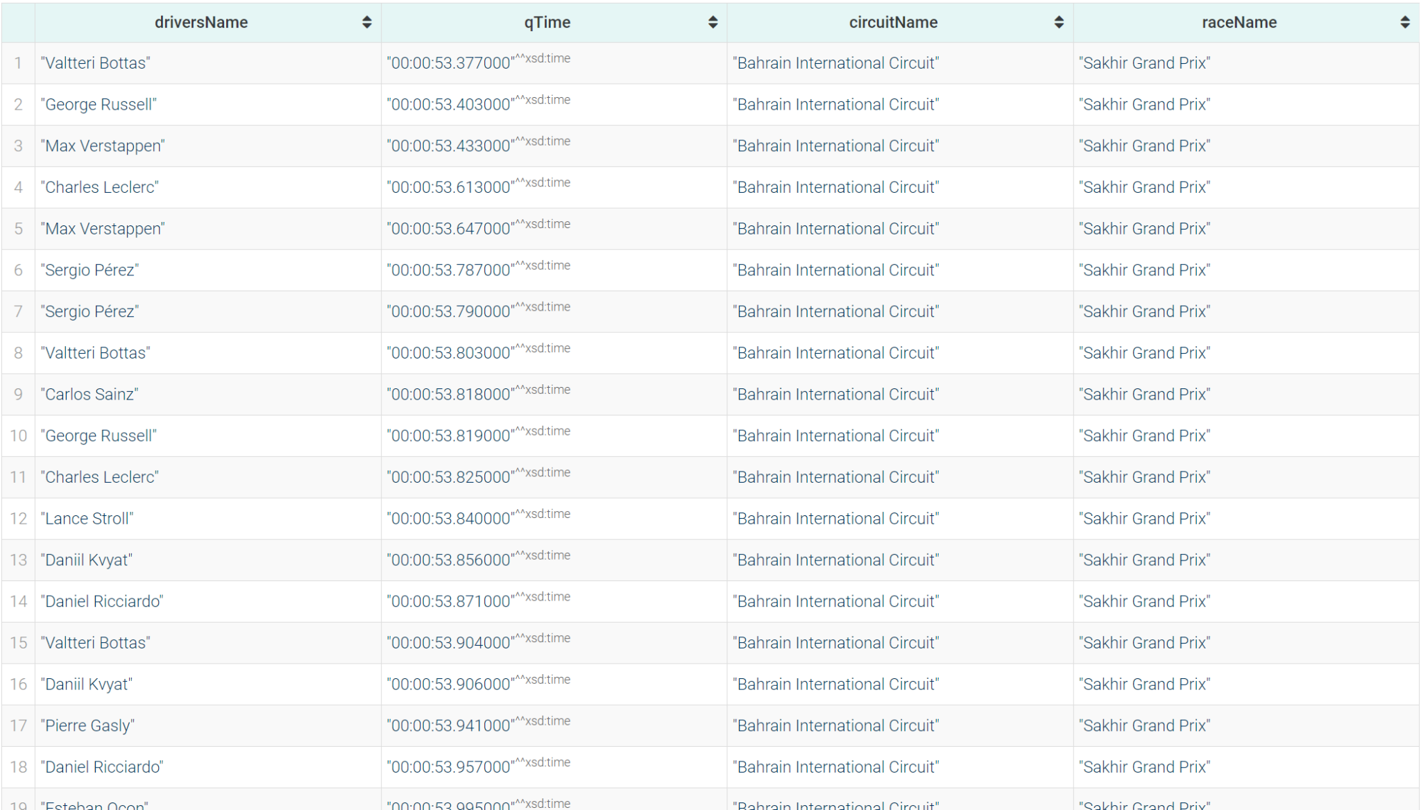
Data about fastest qualifying laps in F1 history (both q1, q2 and q3)
Query 11.3
PREFIX : <https://www.dei.unipd.it/db2/groupProject/FASTianF1#>
PREFIX xsd: <http://www.w3.org/2001/XMLSchema#>
SELECT ?driversName ?qTime ?circuitName ?raceName WHERE {
{
?qualPart :hasQ3Time ?qTime.
}
UNION
{
?qualPart :hasQ2Time ?qTime.
}
UNION
{
?qualPart :hasQ1Time ?qTime.
}
?qualPart :hasDriver ?driver;
:partecipatedInQualif ?quali;
a :QualifPartecipation.
?quali a :Qualifying.
?race a :Race;
:hasA ?quali;
:hasName ?raceName;
:hasCircuit ?circ.
?circ a :Circuit;
:hasName ?circuitName.
?driver a :Driver;
:hasForename ?fname;
:hasSurname ?sname.
BIND(CONCAT(?fname, " ", ?sname) AS ?driversName).
FILTER(?qTime != "00:00:00"^^xsd:time)
}
ORDER BY (?qTime)
LIMIT 100
SPARQL RESULT:

Slide 24
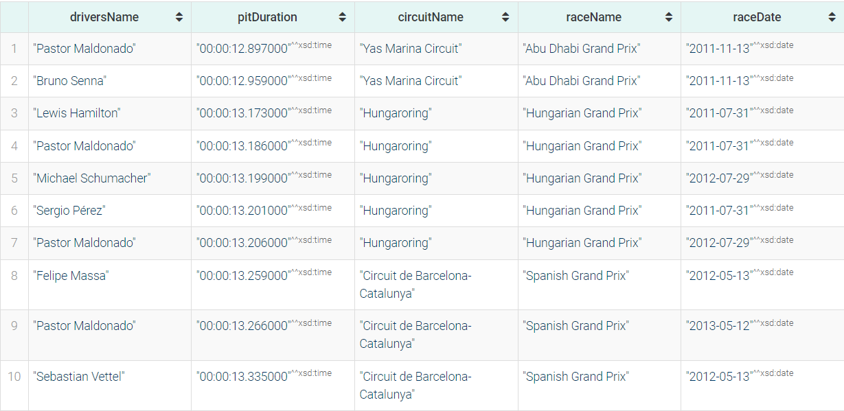
Data about 10 fastest pit stop in F1 history
Query 12
PREFIX : <https://www.dei.unipd.it/db2/groupProject/FASTianF1#>
PREFIX xsd: <http://www.w3.org/2001/XMLSchema#>
SELECT ?driversName ?pitDuration ?circuitName ?raceName ?raceDate WHERE {
?racePart :hasPitStop ?pit;
:hasDriver ?driver;
:partecipatedInRace ?race;
a :RacePartecipation.
?race a :Race;
:hasName ?raceName;
:hasDate ?raceDate;
:hasCircuit ?circ.
?circ a :Circuit;
:hasName ?circuitName.
?pit a :PitStop;
:hasDuration ?pitDuration.
?driver a :Driver;
:hasForename ?fname;
:hasSurname ?sname.
BIND(CONCAT(?fname, " ", ?sname) AS ?driversName).
}
ORDER BY (?pitDuration)
LIMIT 10
SPARQL RESULT:

Slide 25
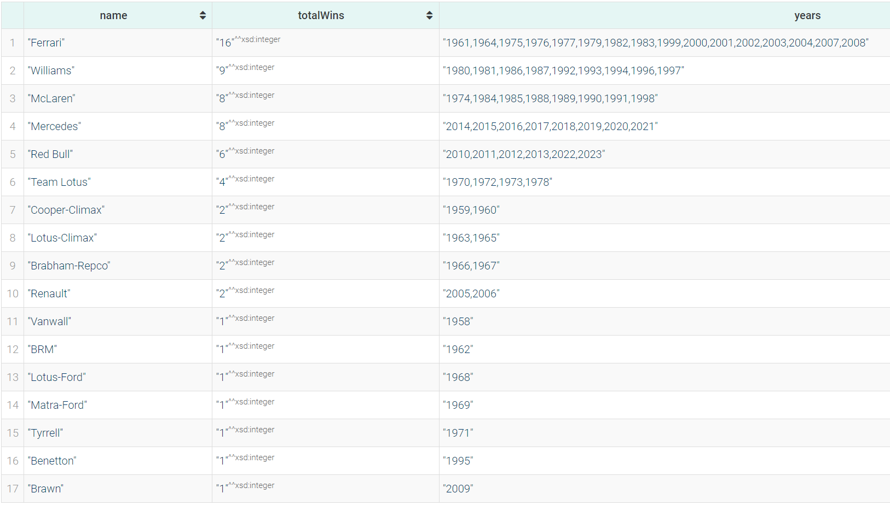
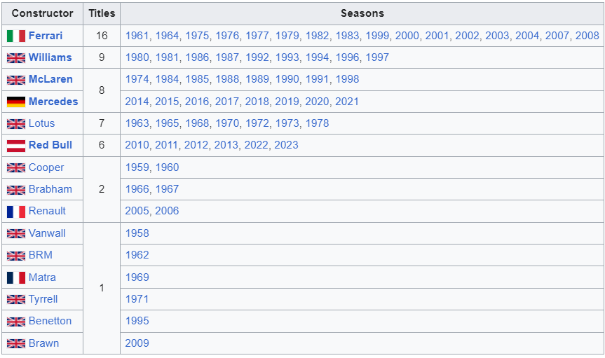
Constructors with most wins in the constructors' championship
Query 14
SPARQL RESULT:
PREFIX : <https://www.dei.unipd.it/db2/groupProject/FASTianF1#>
SELECT ?name (COUNT(?name) AS ?totalWins) (GROUP_CONCAT(DISTINCT ?outerYear ; separator=",") AS ?years) WHERE{
{
SELECT ?name ?race (AVG(?pos) AS ?finalPosition) ?outerYear WHERE{
?stand :hasRace ?race ;
:hasConstructor ?cons ;
:hasTotalPosition ?pos .
?race :hasRound ?outerRound ;
:inSeason ?outerSeason .
?outerSeason :hasYear ?outerYear .
?cons :hasName ?name .
FILTER(?outerRound = ?maxRound && ?outerYear = ?year && ?pos = 1)
{
SELECT ?year (MAX(?round) AS ?maxRound) WHERE {
?race :inSeason ?season ;
:hasRound ?round .
?season :hasYear ?year .
}
GROUP BY ?year
}
}
GROUP BY ?name ?race ?outerYear
ORDER BY (?outerYear)
}
}
GROUP BY ?name
ORDER BY DESC (?totalWins)
WIKIPEDIA:

Slide 26

Are drivers who won the championship after 2000 older than those who won it before 2000, on average?
Query 16
PREFIX : <https://www.dei.unipd.it/db2/groupProject/FASTianF1#>
ASK WHERE{
{
SELECT (AVG(?age) as ?avgOldAge) WHERE{
?stand :hasRace ?race ;
:hasDriver ?driv ;
:hasTotalPosition ?pos .
?driv :hasDateOfBirth ?dob .
?race :hasDate ?raceDate ;
:inSeason ?outerSeason ;
:hasRound ?outerRound .
?outerSeason :hasYear ?outerYear .
BIND((YEAR(?raceDate) - YEAR(?dob)) AS ?age)
FILTER(?outerRound = ?maxRound && ?outerYear = ?year && ?pos = 1)
{
SELECT ?year (MAX(?round) AS ?maxRound) WHERE {
?race :inSeason ?season ;
:hasRound ?round .
?season :hasYear ?year .
FILTER(?year < 2000)
}
GROUP BY ?year
}
}
}
{
SELECT (AVG(?age) as ?avgRecentAge) WHERE{
?stand :hasRace ?race ;
:hasDriver ?driv ;
:hasTotalPosition ?pos .
?driv :hasDateOfBirth ?dob .
?race :hasDate ?raceDate ;
:inSeason ?outerSeason ;
:hasRound ?outerRound .
?outerSeason :hasYear ?outerYear .
BIND((YEAR(?raceDate) - YEAR(?dob)) AS ?age)
FILTER(?outerRound = ?maxRound && ?outerYear = ?year && ?pos = 1)
{
SELECT ?year (MAX(?round) AS ?maxRound) WHERE {
?race :inSeason ?season ;
:hasRound ?round .
?season :hasYear ?year .
FILTER(?year >= 2000)
}
GROUP BY ?year
}
}
}
FILTER(?avgRecentAge > ?avgOldAge)
}
SPARQL RESULT:
Before 2000 avg age:
33.0
After 2000 avg age:
28.8

Slide 27
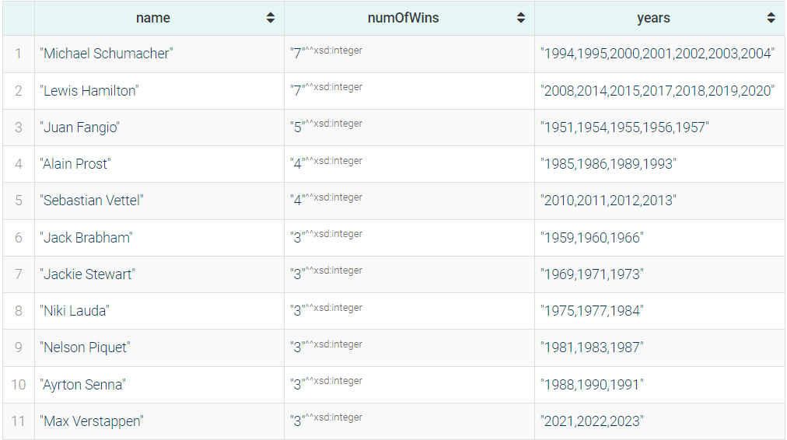
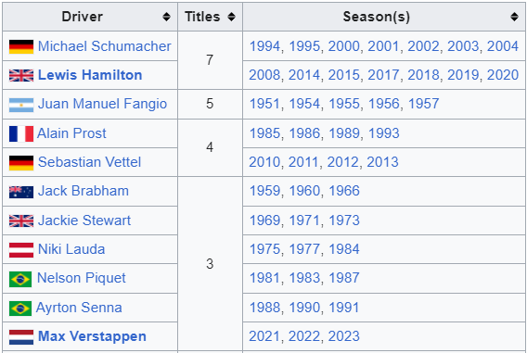
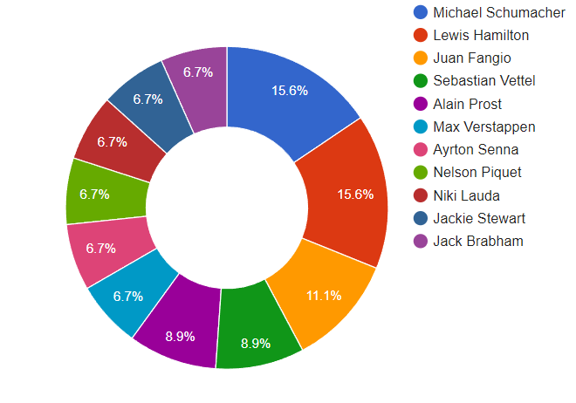
Championship winning drivers who won more than 2 championships, ordered by number of championships won
Query 19
SPARQL RESULT:
PREFIX : <https://www.dei.unipd.it/db2/groupProject/FASTianF1#>
SELECT ?name (COUNT(?name) AS ?numOfWins)(GROUP_CONCAT(DISTINCT ?outerYear ; separator=",") AS ?years) WHERE{
?stand :hasRace ?race ;
:hasDriver ?driv ;
:hasTotalPosition ?pos .
?driv a :Driver;
:hasForename ?fname;
:hasSurname ?sname.
BIND(CONCAT(?fname, " ", ?sname) AS ?name).
?race :hasDate ?raceDate ;
:inSeason ?outerSeason ;
:hasRound ?outerRound .
?outerSeason :hasYear ?outerYear .
FILTER(?outerRound = ?maxRound && ?outerYear = ?year && ?pos = 1)
{
SELECT ?year (MAX(?round) AS ?maxRound) WHERE {
?race :inSeason ?season ;
:hasRound ?round .
?season :hasYear ?year .
}
GROUP BY ?year
ORDER BY ?year
}
}
GROUP BY ?name
HAVING (?numOfWins > 2)
ORDER BY DESC (?numOfWins)
WIKIPEDIA:

Slide 28
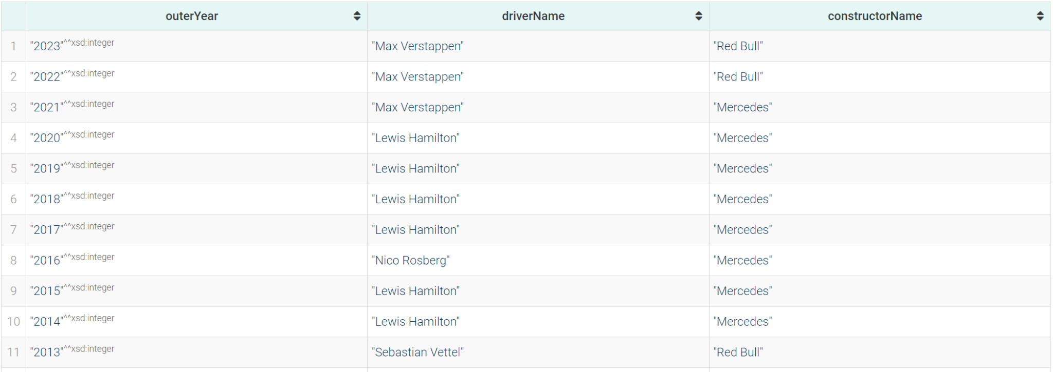
Winners of driver's championship and constructor's championship for each season.
Query 22
PREFIX : <https://www.dei.unipd.it/db2/groupProject/FASTianF1#>
SELECT ?outerYear ?driverName ?constructorName WHERE{
?driverStand :hasTotalPosition ?pos ;
:hasRace ?race ;
:hasDriver ?driver .
?constStand :hasTotalPosition ?pos ;
:hasRace ?race ;
:hasConstructor ?const .
?race :hasRound ?outerRound ;
:inSeason ?season .
?season :hasYear ?outerYear .
?driver :hasForename ?fname ;
:hasSurname ?sname .
?const :hasName ?constructorName .
BIND(CONCAT(?fname, " ", ?sname) AS ?driverName).
FILTER(?outerRound = ?maxRound && ?outerYear = ?year && ?pos = 1)
{
SELECT ?year (MAX(?round) AS ?maxRound) WHERE {
?race :inSeason ?season ;
:hasRound ?round .
?season :hasYear ?year .
}
GROUP BY ?year
}
}
ORDER BY DESC (?outerYear)
SPARQL RESULT:

Slide 29
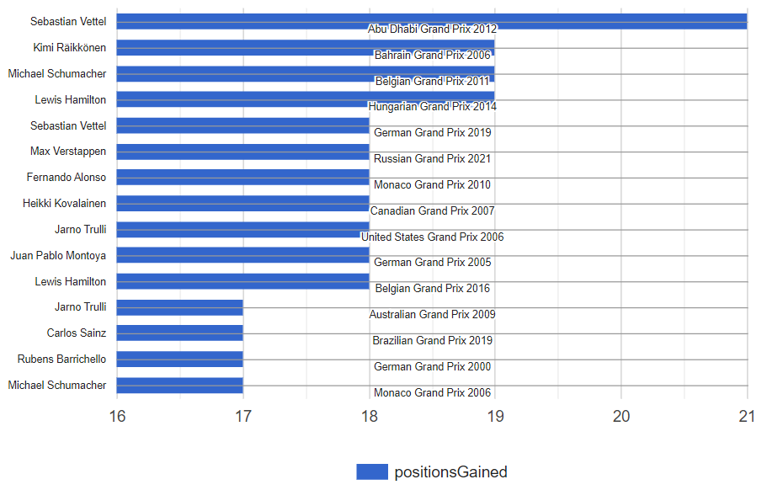
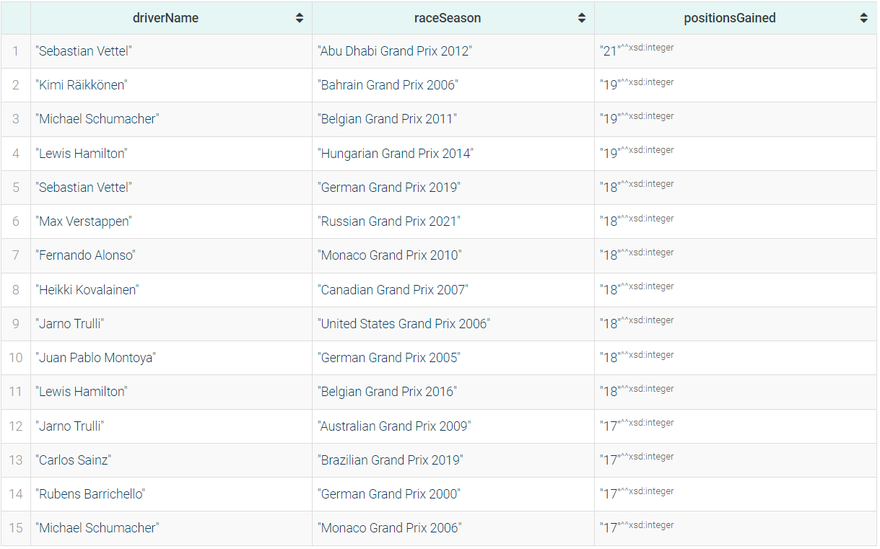
Drivers who gained the most positions during a race after 2000
Query 23
BAR CHART:
PREFIX : <https://www.dei.unipd.it/db2/groupProject/FASTianF1#>
SELECT ?driverName ?raceSeason ?positionsGained WHERE{
?part :hasStartingGridPosition ?grid ;
:partecipatedInRace ?race ;
:hasDriver ?driver ;
:hasPosition ?pos .
?driver :hasForename ?fname ;
:hasSurname ?sname .
?race :inSeason ?season ;
:hasName ?raceName .
?season :hasYear ?year .
FILTER(?year >= 2000)
BIND((?grid - ?pos) AS ?positionsGained)
BIND(CONCAT(?fname, " ", ?sname) AS ?driverName)
BIND(CONCAT(?raceName, " ", STR(?year)) AS ?raceSeason)
}
ORDER BY DESC (?positionsGained)
LIMIT 15
SPARQL RESULT:

Slide 30
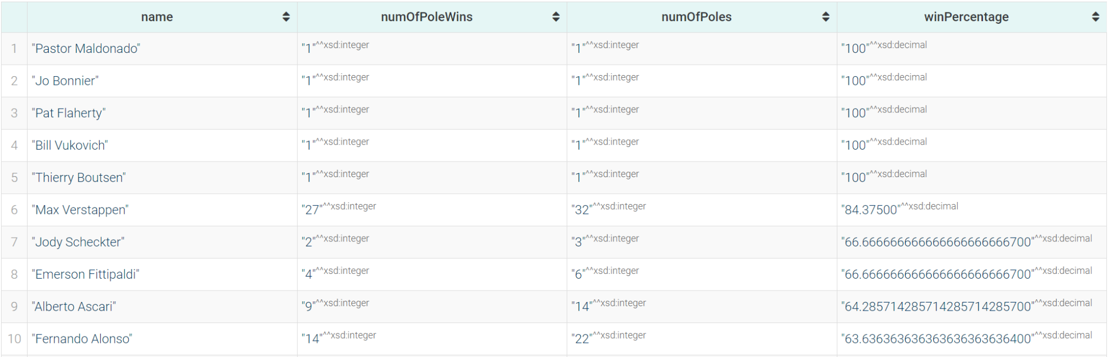
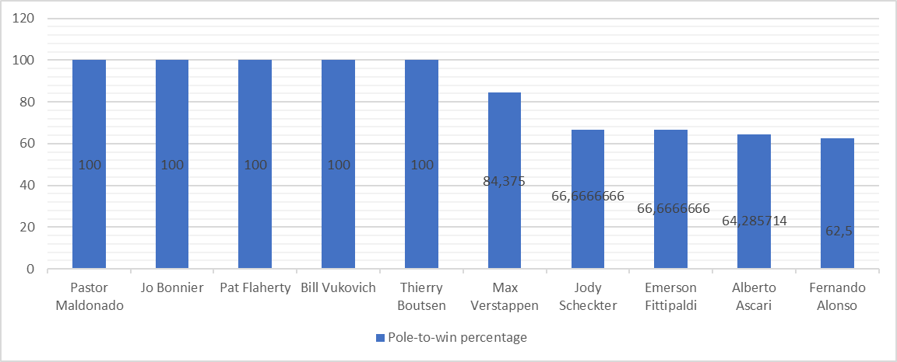
Drivers ordered by pole-to-win percentage (percentage of races won starting from the first position in grid)
Query 24
SPARQL RESULT:
PREFIX : <https://www.dei.unipd.it/db2/groupProject/FASTianF1#>
SELECT ?name ?numOfPoleWins ?numOfPoles ?winPercentage WHERE{
{
SELECT ?name (COUNT(?name) AS ?numOfPoleWins) WHERE{
?racePart :partecipatedInRace ?race ;
:hasDriver ?driv ;
:hasStartingGridPosition ?startPos ;
:hasPosition ?pos .
?driv a :Driver;
:hasForename ?fname;
:hasSurname ?sname.
BIND(CONCAT(?fname, " ", ?sname) AS ?name).
FILTER(?startPos = 1 && ?pos = 1)
}
GROUP BY ?name
}
{
SELECT ?name (COUNT(?name) AS ?numOfPoles) WHERE{
?racePart :partecipatedInRace ?race ;
:hasDriver ?driv ;
:hasStartingGridPosition ?startPos .
?driv a :Driver;
:hasForename ?fname;
:hasSurname ?sname.
BIND(CONCAT(?fname, " ", ?sname) AS ?name).
FILTER(?startPos = 1)
}
GROUP BY ?name
}
BIND((?numOfPoleWins / ?numOfPoles) * 100 AS ?winPercentage)
}
ORDER BY DESC (?winPercentage)
BAR CHART:

Slide 31
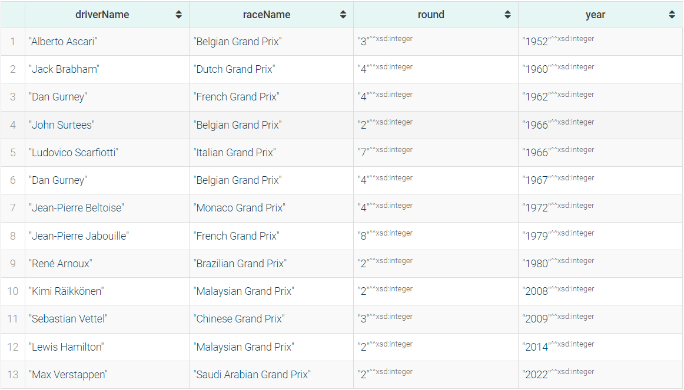
Drivers who finished first in a race and were placed in the last quarter in the standing at the previous race
Query 25
PREFIX : <https://www.dei.unipd.it/db2/groupProject/FASTianF1#>
SELECT ?driverName ?raceName ?round ?year WHERE{
?race :hasRound ?round ;
:inSeason ?season ;
:hasName ?raceName .
?part :partecipatedInRace ?race ;
:hasPosition ?pos ;
:hasDriver ?driver .
?driver :hasForename ?fname ;
:hasSurname ?lname .
?season :hasYear ?year .
BIND((?round-1) AS ?prevRound)
BIND(CONCAT(?fname," ",?lname) AS ?driverName)
FILTER(?pos = 1 && EXISTS{
?prevRace :hasRound ?prevRound ;
:inSeason ?season .
?stand :hasRace ?prevRace ;
:hasDriver ?driver ;
:hasTotalPosition ?totPos .
FILTER (?totPos >= ((?maxPos/4)*3) && ?prevRace = ?raceMax)
{
SELECT ?raceMax (MAX(?totPos) AS ?maxPos) WHERE {
?standing a :DriverStanding ;
:hasRace ?raceMax ;
:hasTotalPosition ?totPos .
}
GROUP BY ?raceMax
}
})
}
ORDER BY (?year)
SPARQL RESULT:

Slide 32
Thank you!

